Slide 1
Inspiratory Splitter Box
A
Filter
Patient A Tubing
Ventilator
Inspiratory Arm
B
Filter
Patient B Tubing
Bias Circuit
Expiratory Splitter Box
Expiratory Arm
A
Filter
Patient A Tubing
B
Filter
Patient B Tubing
This design will allow a modern ventilator to have a splitter. The key innovation here came from the Differential Multiventilation group– the Bias Circuit. That circuit bypasses the compensatory electronics inside the ventilator by providing the ventilator with immediate feedback for the bias flow Inspiratory and Expiratory Splitter Boxes are on the pages to follow. #project-4-way-ventilator, Helpful Engineering (rev 9, 20 May 2020)

Slide 2
Ventilator Splitter Box (VSB)
Inspiratory Section
Ventilator
1-Way Valve
P1 Flow Control
P1 Shutoff
P1 Inspiration
Inspiratory
Arm
1-Way Valve
P2 Flow Control
P2 Shutoff
P2 Inspiration
1-Way Valve
P3 Flow Control
P3 Shutoff
P3 Inspiration
1-Way Valve
P4 Flow Control
P4 Shutoff
P4 Inspiration
1-Way Valve
Bias Circuit
Expiratory Section
Expiratory
Arm
1-Way Valve
1-Way Valve
P1 Flow Meter
P1 Shutoff
P1 Expiration
1-Way Valve
P2 Flow Meter
P2 Shutoff
P2 Expiration
1-Way Valve
P3 Flow Meter
P3 Shutoff
P3 Expiration
1-Way Valve
P4 Flow Meter
P4 Shutoff
P4 Expiration
Tetra Schematics v11
2 June 2020

Slide 3
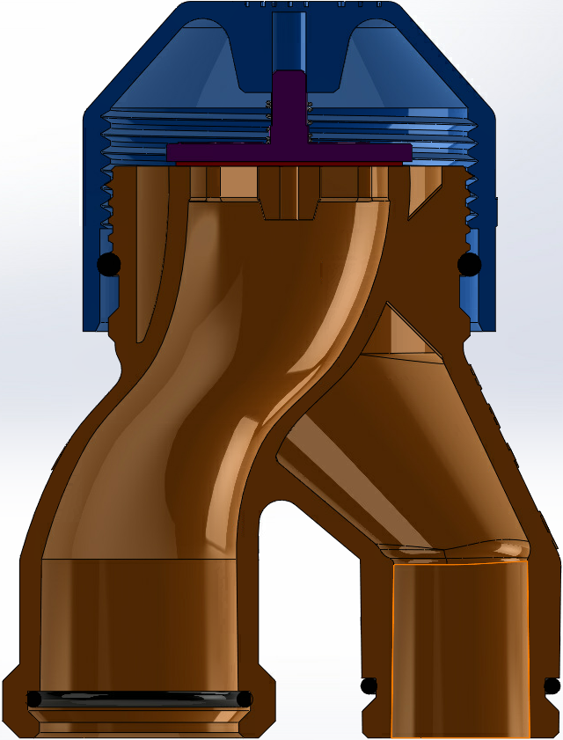
Flow
Cap
Spring
Seal
Airflow
Airflow

Slide 4
Ventilator Input
22mm1-way ->
CPVC
right angle
CPVC
right angle
22mm1-way ->
Ventilator Output
Display
CPVC tube
CPVC tube
Circuitboards
22 mm adaptor
CPVC
Ball Valve
Flow CTRL
1-way
<-
CPVC T
CPVC T
1-way
->
Flow Sensors
CPVC
Ball Valve
22 mm adaptor
Repeat 3x
Repeat 3x
CPVC tube
CPVC tube
CPVC
right angle
CPVC tube
CPVC tube
CPVC
right angle
1-way ->

